Slide 1
Managerial Economics and Financial Analysis
D. MAHESWARI
Assistant Professor
Department of Information Technology
Aditya Engineering College (A)
Email: Maheswari.dama@aec.edu.in

Slide 2
Course Outcomes
At the end of the Course, Student will be able to:
CO 1 :Explain the Managerial Economic concepts for decision making and forward
planning
CO 2 : Illustrate the law of demand and its exceptions by using different
forecasting methods.
CO 3 : Identify the cost behavior for managerial decision making and Break Even
Point (BEP) of an enterprise

Slide 3
Course Outcomes
CO 4 : Classify the different types of business organizations along with basic
knowledge on business cycle.
CO 5 : Make use of the process & principles of accounting for the preparation of
final accounts
CO 6 : Utilize various techniques on investment project proposals with the help of
capital budgeting techniques for decision making

Slide 4
Course Objectives
COB1 :To equip the students with the basic inputs of managerial economics and demand concepts
COB2 :To understand the nature of markets, Methods of Pricing in the different market structures and to know the different forms of Business organization and the concept of Business Cycles
COB3 : To impart the knowledge on production theories, its factors and cost analysis.
COB4 : To make the students take optimal decisions and acquiring the knowledge on financial accounting and its analysis

Slide 5
Course Contents
UNIT I : Introduction to Managerial Economics and
demand Analysis
UNIT II : Production and Cost Analyses
UNIT III: Introduction to Markets, Pricing Policies &
Types of Business Organization and
Business Cycles
UNIT IV: Introduction to Accounting & Financing Analysis
UNIT V : Capital and Capital Budgeting

Slide 6
Text Books
Dr. A. R. Aryasri – Managerial Economics and Financial Analysis, TMH 2011.
Dr. N. Appa Rao, Dr. P. Vijay Kumar: ‘Managerial Economics and Financial Analysis’, Cengage Publications, New Delhi – 2011.
Prof. J.V. Prabhakara rao, Prof. P. Venkatarao. ‘Managerial Economics and Financial Analysis’, Ravindra Publication.

Slide 7
LEARNING OUTCOME
At the end of the This lecture , Student will be able to:
LO 1 : Identify the cost behavior for managerial decision making and Break Even
Point (BEP) of an enterprise

Slide 8
CONTENTS
Concept of Production function- Cobb-Douglas Production function – Law of Variable proportions-Isoquants and Isocosts and choice of least cost factor combination-Concepts of Returns to scale and Economies of scale-Different cost concepts: opportunity costs, explicit and implicit costs- Fixed costs, Variable Costs and Total costs – Cost –Volume-Profit analysis-Determination of Breakeven Point (simple problems)- Managerial significance and limitations of Breakeven point.

Slide 9
The Production Function
Michael R Baye defines production functions as “that function which defines maximum amount of output that can be produced with a given set of inputs”.
The Production functions is more concerned with physical aspects of production. It is the concerned of the engineer rather than that of the manager to know how much can be the production with a given set of inputs.
Production function is an engineering relation that expresses that maximum amount of output that can be produced with a given set of inputs.

Slide 10
INPUT OUTPUT RELATIONSHIP OR PRODUCTION FUNCTION
The inputs for any product or service are land, labour, capital, Organization and technology. In other words the production here is the function of these five variable in puts. Mathematically this is express as
Q = f(L₁, L₂, C, O, T)
Q = quantity of production
F explains the function that is the type of relation between inputs and outputs

Slide 11
Assumptions of Production function
1.The production function is related to a particular period of time.
2. There is no change in technology.
3. The producer is using the best techniques available.
4. The factors of production are divisible.
5. Production function can be fitted to a short run or to long run

Slide 12
LAW OF PRODUCTION:
Production analysis in economics theory considers two types of input-output relationships.
1. When quantities of certain inputs, are fixed and others are variable and
2. When all inputs are variable.

Slide 13
Production function types
1.Production function with one variable
2.Production function with two variables
3.production function with all variable input factors

Slide 14
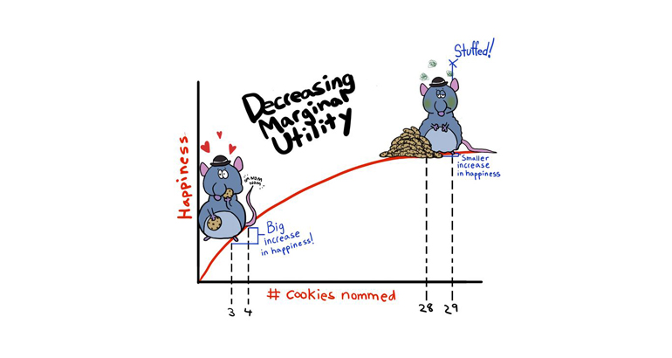

Slide 15
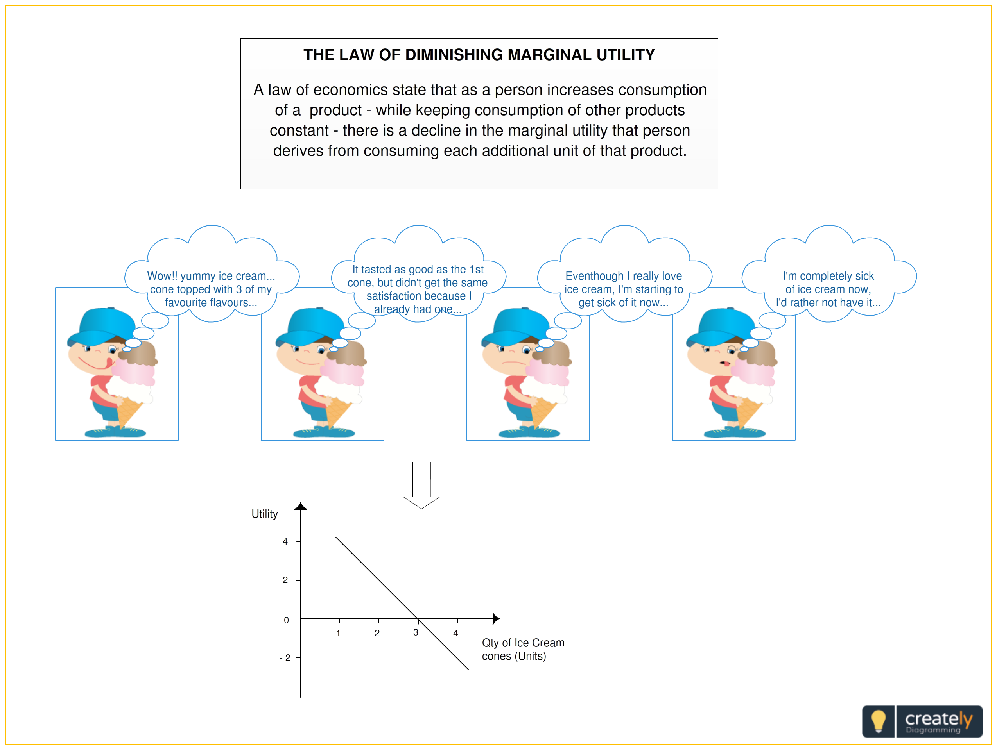

Slide 16
Production function with one variable input or law of Diminishing marginal returns
The law of returns states that when at least one factor of production is fixed and when all other factors are varied that total output in in the initial stages will increase at an increasing rate and after reaching certain level of output the total output will increase at declining rate.
According to Prof Benham “As a portion of one factor is a combination of factors is increased ,after a point First the marginal and average product of that factor will Diminish”

Slide 17
Total product TP= F(QVF)
Average product AP= TP/ QVF
Marginal product= TP2-TP1/Q2-Q1

Slide 18
Units of labour | Total product (TP) | AP | MP
0 | 0
1 | 10
2 | 22
3 | 33
4 | 40
5 | 45
6 | 48
7 | 48
8 | 45

Slide 19
Units of labour | Total product (TP) | Marginal product (MP) | Average product (AP) | Stages
0 | 0 | - | 0 | Stage 1
1 | 10 | 10 | 10
2 | 22 | 12 | 11
3 | 33 | 11 | 11 | Stage 2
4 | 40 | 7 | 10
5 | 45 | 5 | 9
6 | 48 | 3 | 8
7 | 48 | 0 | 6.85 | Stage 3
8 | 45 | -3 | 5.62

Slide 20
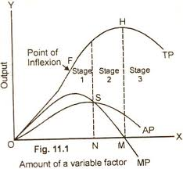

Slide 21
Assumptions of the Law: The law is based upon the following assumptions:
i) The state of technology remains constant. If there is any improvement in technology, the average and marginal output will not decrease but increase.
ii) Only one factor of input is made variable and other factors are kept constant. This law does not apply to those cases where the factors must be used in rigidly fixed proportions.
iii) All units of the variable factors are homogenous.

Slide 22
Set a | Set-b
1.Q= f (QVf) | Marginal cost
2.The rate of output per single unit of input factor | Total product
Tp increased at a increased rate | Stage-2
Mp is in negative stage | Stage-3
Ap=Mp in -----stage | Stage-1
The additional out put produced by using additional input factor | Average product

Slide 23
Thank you

